Slide 1
The Power of kdb+q
What's so special about kdb+?
What can it do for me?
Ryan Hamilton
Notes:
Read Slide

Slide 2
Scaling kdb+
Background to Problem
Users – Team – Feedback
Kdb+ Architecture
Investigate
Patch, Quick wins, Plan
Tick Basics
Scaling out Tick
Common kdb+ Problems
Common Growing Pains
Costly Mistakes
Secret Weapons
Notes:
Read Slide

Slide 3
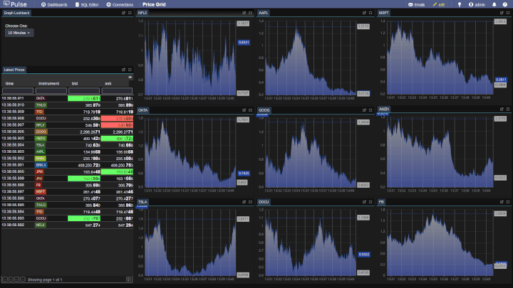
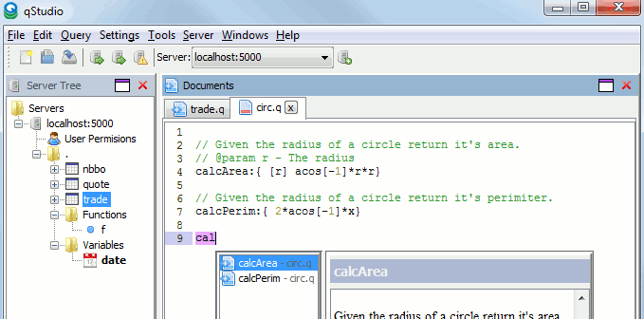
Ryan Hamilton
MS -> UBS -> Citi
TimeStored
Training
qUnit
qStudio
Pulse
Notes:
My name is Ryan Hamilton
I’ve previously build systems, mostly kdb+ based at MS, UBS, Citi.
At MS I got to work on probably the oldest largest deployment of kdb+ systems in the world.
At UBS I worked on the equities market data platform.
And at Citi, if you query almost any market data except equities, you are probably interacting with a system I or my team built.
Additional to building systems internally for banks.
For the last 10 years my business partner John and I have been running Timestored.
We’ve provided training to 100s of individuals and provided software tools.
The most popular currently is qStudio an IDE for kdb.
Our newest tool is Pulse, a real-time visualization tool for kdb and other databases.

Slide 4
Notes:
As a bit of background I would like to try and outline what we are building
as I’m aware not everyone listening this presentation may have been working solidly in kdb for years.
Let’s start our game.
We are going to build a firm wide analytics platform.

Slide 5
Data App Pyramid
Basic Select
Data storage
Hardware
Finance APIs
Analytics
Users / Action
External APIs / Market Data
Notes:
The goal is to build a data app pyramid.
The pyramid relies on all bottom layers to allow building to a pinnacle of user happiness and action.
We take raw data at the bottom
Build a platform of hardware/storage/APIs then finance specific APIs
Which finally allows us to, at the top, achieve action.
This action is very important.
If you are gathering or storing data but it’s not being used for action or profit. It’s a waste of time.
IF the data is too messy or of the wrong structure to use, it’s also useless.
Our whole goal is that action.

Slide 6
Mission: Deliver Market Data
Users
Team
Feedback
Notes:
Our mission is to deliver market data.
There are 3 key pre-requisites
Users – That are smart, engaged and can use good market data to make the firm money.
If you don’t have good users, your first job should be to find them or leave.
No good developer wants to build an “imaginary system” – Long term….
Team - You want good developers NOT great coders.
Coders can write code. We want people that can develop solutions.
All the way from speaking to users, working out requirements, developing, delivering, supporting and operating that solution.
Then listening to feedback.
Third is Feedback. I’ve mentioned it here as it is critical for any software development team to create an efficient delivery pipeline and to allow feedback at all stages.
OK so we have users/teams and a good feedback cycle.
You have landed into your new company or office, it’s day 1.

Slide 7
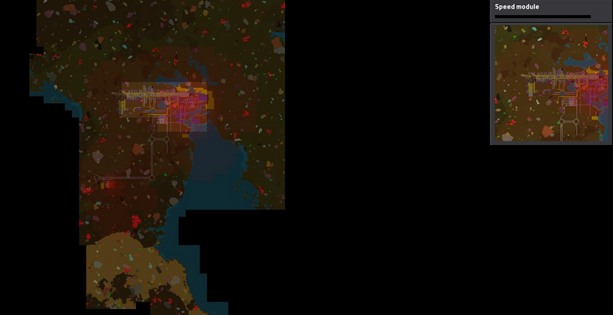
Day 1 – Investigate
You have either inherited a beautiful green field
Or messy brown field with pieces scattered
What resources do you have access to?
Notes:
What you have
What users are currently doing
What they find painful
What they want to do

Slide 8
Day 2 – Patch, quick wins, Plan
Notes:
If you were lucky, nothing broke on your first day.
But now it’s day 2 and something is probably breaking.
Fix anything breaking
Quick Wins
Turn on logging ASAP
Plan
Outline all problems
Outline all user requests
Say what you are going to work on
Decide any changes in how team operates
Reach rough team consensus
Email it to everyone!
User Contract / API

Slide 9
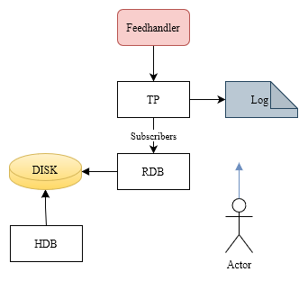
Day 3 – Tick Basics
Problem: Storing market data
FH – Processes data
TP – Logs to disk
Forwards to listeners
RDB
Keeps recent in RAM
Answers user queries
HDB
Provides access to historical data from persistent storage
Notes:
Day 3 – We can finally get into the architecture.
To make sure we are all starting from the same idea. This is kdb tick.
A simple setup to allow capturing one database of data on one machine.
Read Slide

Slide 10
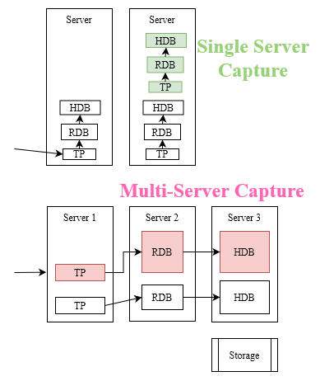
Day 4 – Scaling Out Tick
Problem: Reasonably allowing multiple databases
Pivot Points for:
Storage
DDN / Raid / SSD / S3
Server-Split
Efficiency, reliability
Launcher
Kubernetes
Bash
SSH
Cloud vs On-Prem
Notes:
Day 4. After the success of one capture, our users are demanding we capture more data sets?
How do we expand to multiple data sets?
How are we going to scale and deploy Tick?
Very early on you will need to make some long term decisions.
I’m not going to try and say what is best as I don’t believe that’s possible.
What I would like to suggest is a framework for deciding.
As a team, rather than arguing A against B. Try to decide what parameters would cause a tipping point.
Considering Storage
- Do NOT pose the question as SAN or DDN. Ask what is the tipping point?
- What is available within the firm?
- How much effort to onboard external solution? For what benefit?
- Tipping point – If need very fast local SSD else RAID. As RAID provides reliability and easier failover.
The next item I want to mention is Server-Split
I’m bringing it up as I’ve seen a number of firms get this badly wrong and in this case I think there are very few pivot points that suggest multi-server.
Single Server – Is when we host the FH/TP/RDB/HDB all on one host.
Multi-Server – Is we split the capture with specialised servers for certain tasks.
Only maybe if you have a hugely specialized setup for HDB = Multi-Machine make sense.
If the goal is:
- Easy scaling without special machine weighting = One Machine
- Efficiency – to prevent lots of messaging on network = One Machine
- Reliability – to decrease outage from one server failure = One Machine
Launcher
- How does it currently work?
- What does the team know well?
- How many machines will you be deploying per year?
These decisions will allow you to spread out to multiple databases.

Slide 11
Day 5 – Common kdb+ Problems
You scaled out but now you can’t manually jump in and fix issues yourself. You need to automate improvements to the core stack.
Problems -> Solution
Slow consumer risks TP -> Chained TP
Cutoff slow subscribers
Long user queries block HDB -> -T timeouts
Bad user queries -> GW + -g + auto-restart
High TP/RDB CPU - batching
End of day Savedown blocks queries -> WDB
Persist data throughout day to temp location
Sort slow = perform offline
Notes:
Goto Image

Slide 12
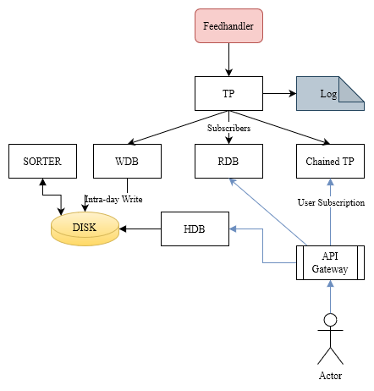
Notes:
You scaled out but now you can’t manually jump in and fix issues yourself. You need to automate improvements to the core stack.
These are issues that everyone encounters and there are well documented solutions.
Problems -> Solution
Slow consumer risks TP -> Chained TP
Cutoff slow subscribers
End of day Savedown blocks queries -> WDB
Persist data throughout day to temp location
Sort slow = perform offline
Long user queries block HDB -> -T timeouts
Bad user queries -> GW + -g + auto-restart
High TP/RDB CPU - batching

Slide 13
Day 6 – Common Growing Pains
Problems:
We scaled out even further and now processes are everywhere
We need security everywhere
Some databases are too large for one machine
Users querying host:port RDB/HDB direct
Won’t work if server dies
Requires expertise
Users can’t find data
Notes:
Read Slide

Slide 14
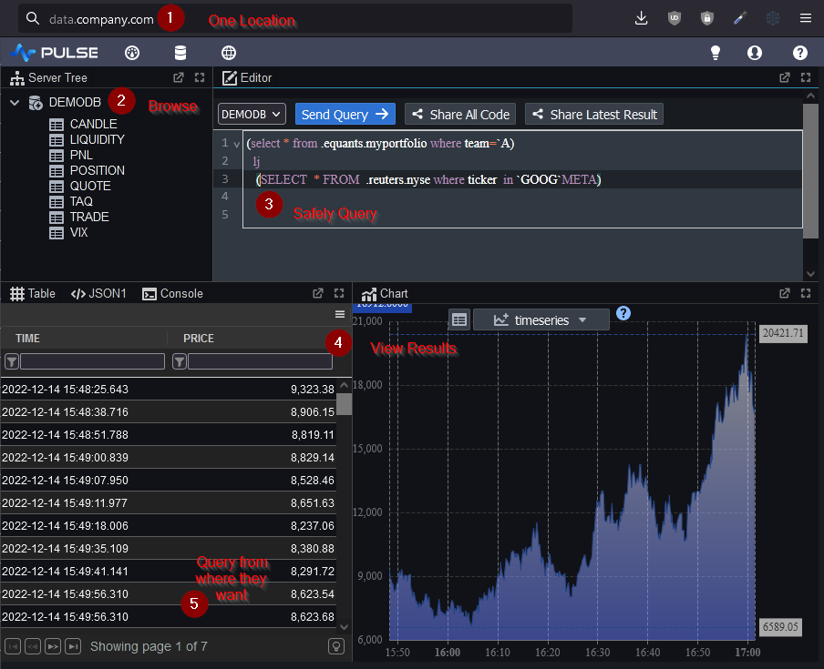
Notes:
Well let’s think what users actually want and need.
Users just want their data in the format/location of their choice.
They don’t want to know how your system works, they don’t want to read a lot of confluence or docs, they may be content talking to you.
I think we can agree from user perspective going to one single address is the easiest.
Ideally they don’t want to care where data lives, they just want it to be fast and reliable.
Let’s pretend we have a MegaGW that allows that.
It provides one point of entry, with a webUI that allows selecting over all data.
To allow that select we will need to know where everything is.

Slide 15
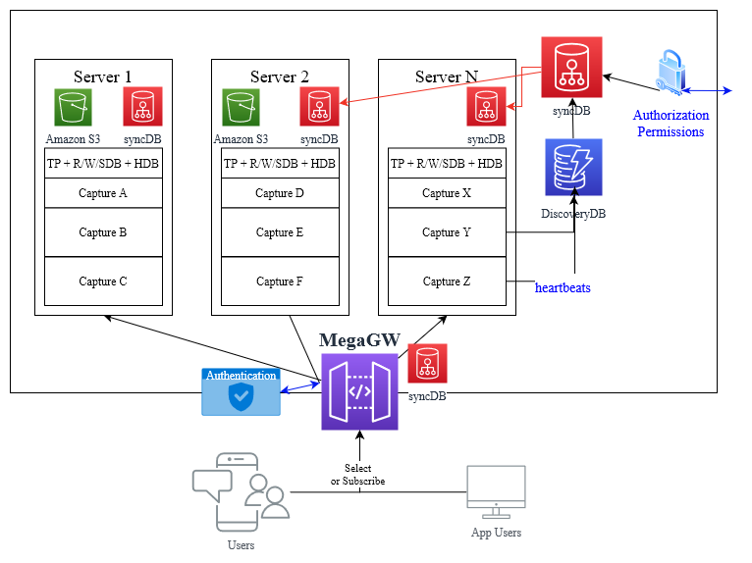
Notes:
So this MegaGW
- Is going to seem like one central location to the user
- That let’s them send one consistent query
- Preview the result
- and query it simply from whatever API they choose.
To make that MegaGW work we first need 2 components.
A discovery service – that allows instances to register.
A syncDB – that propagates that information reliably to all processes.
Choices:
Use kdb? Zookeeper? Middleware? Kubernetes? – Tipping point = good fit for kdb? Team expertise?
Loads of business decisions in here, how long to keep service registered if heartbeat stops? What if it’s data is stale?
DiscoveryDB
My preference is to use kdb as it seems well suited and the team has expertise.
So now when every process starts it will send a regular heartbeat to one or more discovery databases.
On a separate timer, the DiscoveryDB will publish the list of existing services to syncDB.
syncDB
Will have a master process, that then sends updates to all servers and downstream processes.
When any capture on a server wants to query a sync setting, it calls the API which looks at the most local instance only.
It’s designed to NOT be fast but to be hyper reliable. We are not spinning up/down instances every minute.
These are mostly databases that sit on large data stores so caching them for long periods is fine.
Worst case we query a non-existant server and timeout. What we don’t do is delete or flush the cache.
OK so now we have this MegaGW that knows where everything is but how does it actually work?

Slide 16
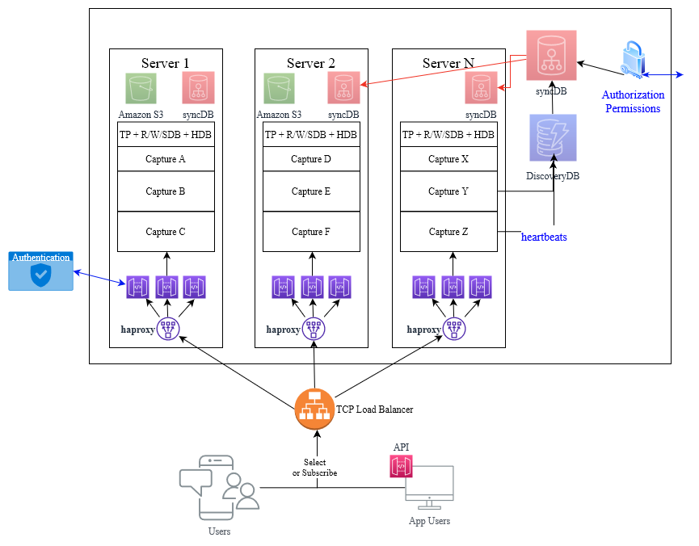
Notes:
OK so now we have this MegaGW that knows where everything is but how does it actually work?
It can take a user query, see where it needs sent to, send queries to that location and return the result.
We can make one process like that but how do we scale it up to 100s of users while looking like one address?
I don’t have time to go into every variation I’ve seen or considered so I’ll just show one possibility:
Starting from the User Query:
- They connect to a domain name, let’s say data.company.com
- That is a TCP load balancer, that rotates over multiple servers. So it connects to port 9000 on server 1
- Running on port 9000 on server 1 is another load balancer, software based haproxy, which will forward/return data from one of the underlying q processes.
- So let’s say between port 9000-9010 – we are running 10 megagw processes
- Each MegaGW is a q process that has a table listing all the data sources
- We override .z.pg to break apart the user query and forward it to the relevant machines and return the result.
The nice thing here is that we’ve used off-the-shelf components, there is NO-CODE. The best code is no-code.
The load balancers only knows it’s forwarding connections.
Meanwhile we can program the MegaGW as if it’s just one small component.
It will behave to the user exactly like a standard q process, meaning all the existing API and tools like qStudio will just work.
Now if you’ve seen similar configurations e.g. Torq/Delta, you will notice some differences:
I’ve gone fully sync
Every MegaGW has the same API
Thinking about it from the user perspective and what the they want. Those other frameworks are just wrong.
Users do not want to know of multiple proxies and they want one simple consistent API.
Scaling – If MegaGW is central how do we prevent failure? Either we can centralise and possibly fail or decentralise and be less user friendly?
I think the sliding scale of options goes from:
- Full decentralization – push the logic to a driver API on the user side.
- Full centralization – Have one location (Now with DNS / Hardware loadbalancers / AWS / haproxy) we can distribute that to a degree.
Pivot Point – user speed vs numbers? 700 slow selectors = central – 5 fast subscribers = API
Mostly I would lean to creating the central first and then actually basing the API on it.

Slide 17
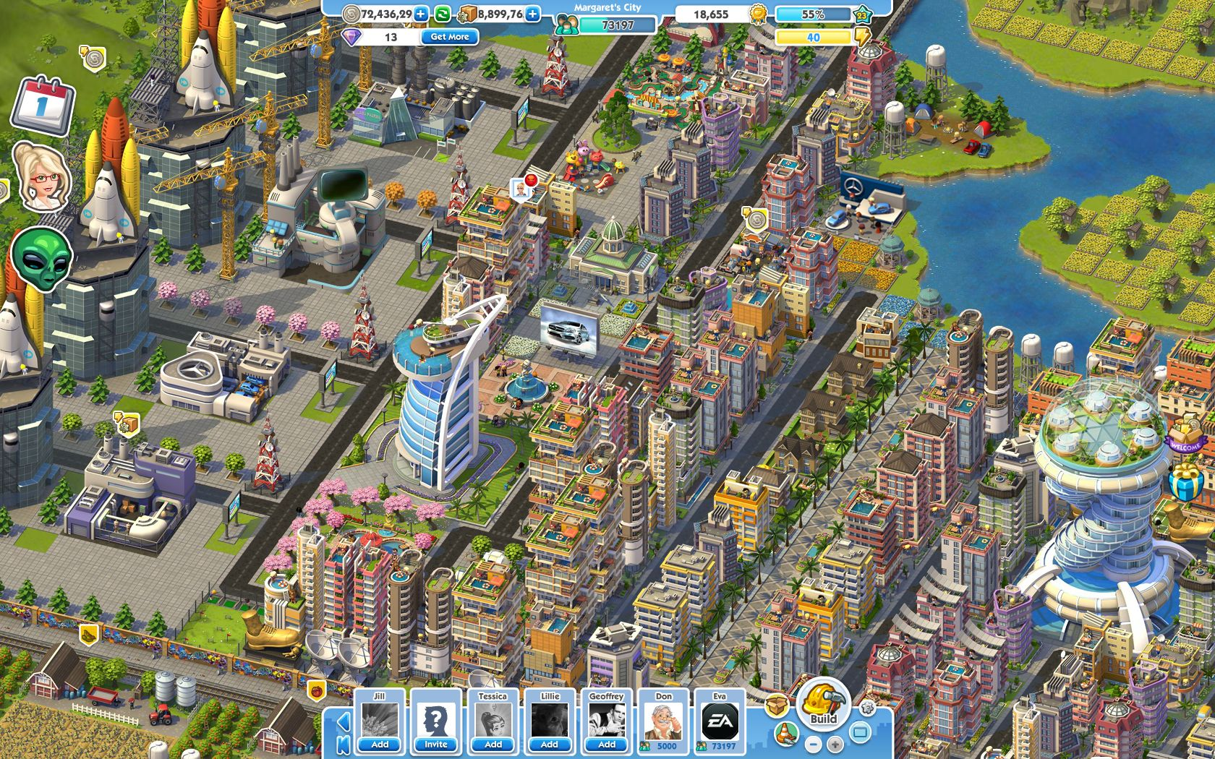
Notes:
Congratulations, you’ve built a wonderful system
That with some small tweaks will scale to 400 Users

Slide 18
Congratulations
Day 1-2 – 0-10 Users – 1-2 Databases
Day 3-4 – 10-50 Users – Scaled out Tick
Day 5 – 50-100 – CTP/GW/WDB – Timeouts
Day 6 – 100-400 – MegaGW – Service Disco
Day 7 – Expand up or out.
Up = APIs / apps / sandboxes
Out = More data captures across asset classes
Notes:
Read Slide

Slide 19
Day 7
Mega-Selects – beautiful user API
Sharding – captures larger than 1 machine
Middleware – IPC or solace or kafka
User Sandboxes
Hosted API – Allowing other teams to define kdb APIs in megaGW safely
Apps – As well as captures, host RTEs
Failover
Regional – hosted databases
Improved Load-balancing. Persistent connections.
Notes:
Examples of some things you may implement include:

Slide 20
Notes:
Looking back, how did I do at the game and what would I do differently?
Costly Mistakes
Complex Packaging – Choose wrong packaging method. Rather than modules building and relying, I should have had a flat file loader. That can load everything.
Query Logging should be offline – We reused our kdb infra, to capture logs in near-real time. Very useful for recent debugs but probably not worth the effort.
In hindsight, I’d log to console and have a separate log scraper that uploads that elsewhere.
Hiring / Training - Internal Devs

Slide 21
Secret Weapon Continuous Deployment
Code is read 10x more than it’s written
CI - Continuous Integration at minimum
Invest as much as reasonably possible optimizing the appropriate part of your pipeline. Every developer MUST be able to run new code in a repeatable environment.

Slide 22
Secret Weapons
Require significant effort but return a huge amount of value:
Full Integration Tests
Keep It Simple - Say no to users / management.
The best code is NO-code.
Keep Smelly Working Code - Say no to ourselves.
Non-Code work can pay hugely
Mega-Gateway - Users loved this
S3 Storage – users don’t use old data
Good artists copy; great artists steal

Slide 23
DR – Disaster Recovery
Typically kdb+ is ran HOT-HOT

Slide 24
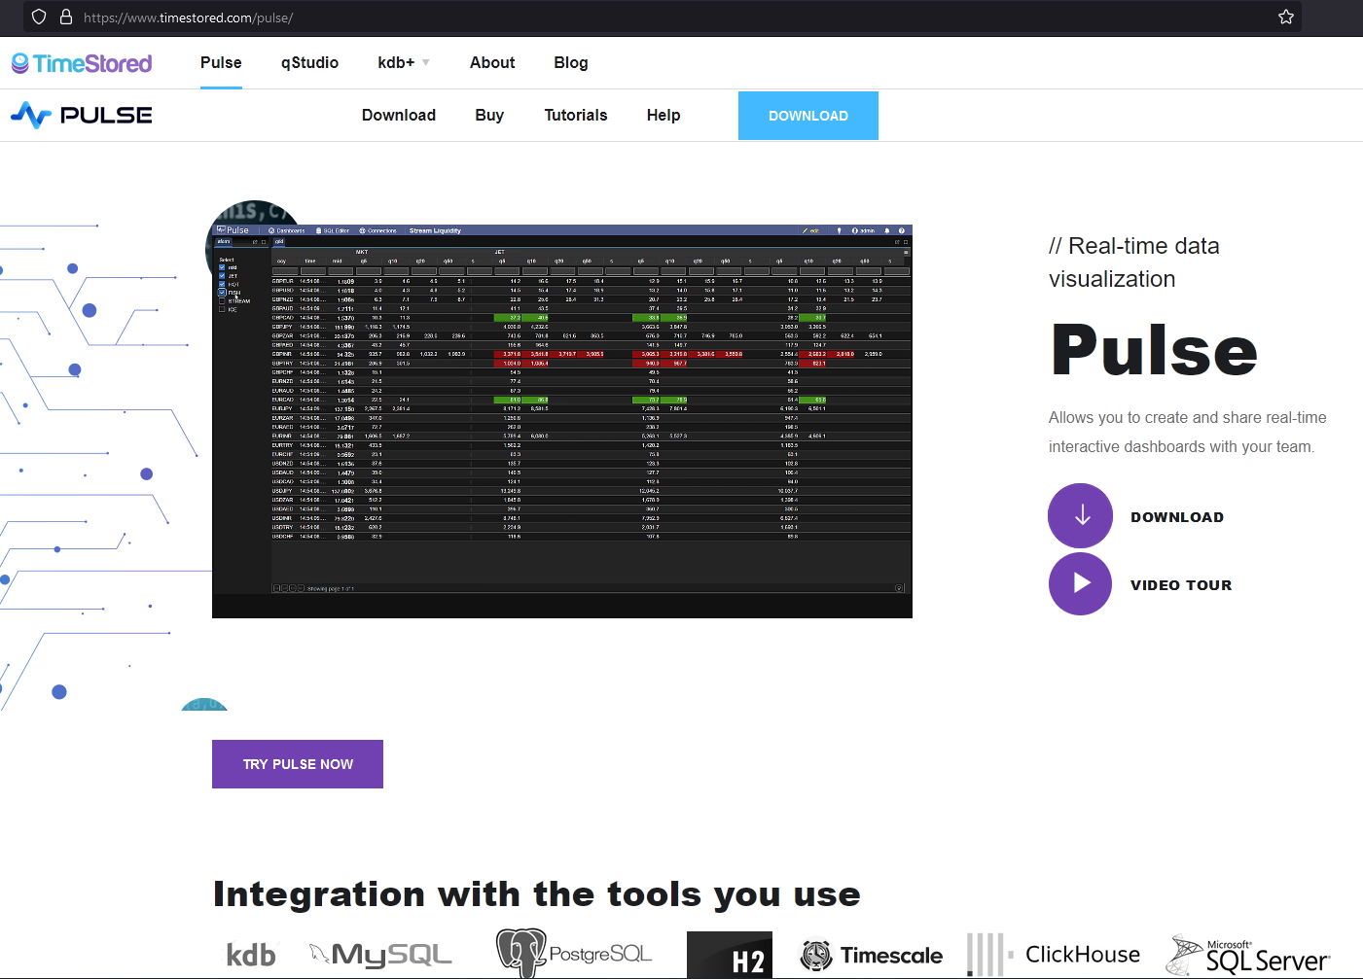

Slide 25
Thanks
I was lucky to work with some great people.
That told me when I was wrong
Showed me better ways to do things
Were patient when I didn’t understand
That includes everyone, quants / developers / management / support staff.
I don’t want to mention names as I would only forget someone
But I would like to say
Thanks

